Slide 1
Proactive Risk Based Alerting for Insider Threats
Splunk .conf21 Breakout Sessions

Slide 2

Matt Snyder
Program Lead - Advanced Security Analytics | VMware

Slide 4

​Everyone has an Insider Threat Problem
​No matter what industry you are in or the size of your company, you face challenges from Insider Threats.

Slide 5
% of Employees likely to leak data post COVID-10
Remote work has accelerated risks
With workforces around the world shifting to remote/work from anywhere models, employees now have greater access to data than ever before.
85%
Source: https://www.code42.com/resources/report-2021-data-exposure/

Slide 6




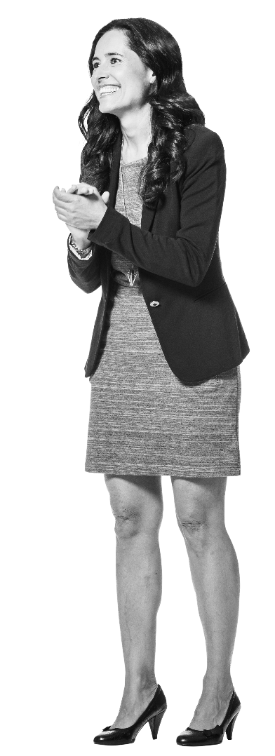


Now it’s time to build a team!

Slide 7
You Need Support
Building strong partnerships is key!
Legal
HR/ER
Privacy
Physical Security
What issues are they concerned with, biggest threats they see.
What are you going to do when you have a case? How do they report a potential issue?
What can and can’t your program do?
Who are you going to call if things get ugly?

Slide 8
Why use Splunk for Insider Threats?

Slide 9
Life Cycle of Investigation
Before Splunk and RBA, the process was slow, time consuming, and reactive!
Issue Reported
Wait for next case
Forensic Image acquired
Review Data
Prepare Report

Slide 10
Enter the Tools!
The Sales Rep promised this product would solve all our problems!!
Endpoint/Agents
Policies will stop bad activity
IDM
Access Control fixes everything!
DLP
Miracle device to detect everything

Slide 11

Too Many False Positives!!!
False Positive
Missed Events
False Positive
False Positive
False Positive
Missed Events
False Positive
False Positive

Slide 12

We deserve better!
So we are going to build it ourselves....
Using the existing infrastructure in Splunk Enterprise Security, we are going to build better detections.

Slide 13
RBA is simple and elegant...
All organic ingredients with no artificial flavors...
Data
You probably already have the data you need, if not, go get it!
Build Correlation Searches
These will have the Risk Analysis action attached and events will be written to the “risk” index
Create Notable Event Searches
These correlation searches run against the “risk” index or data model and have a Notable Event action attached.
Tune and Repeat
Keep reviewing your detections, make adjustments, then do it again.

Slide 14
Life Cycle of Investigation
With the RBA approach and relevant logs, we can proactively address issues that would never have been discovered, in a way that is scalable and efficient.
24/7 Detections Running
Close Out Case
Alert is Triggered
Review Alert
Phantom Automations

Slide 15
Does it work?
Real stats from a real program
Pre Splunk
Pre RBA
RBA
Program Dev
Total Detections
1 Week
1-2 Days
10 Minutes
3 Weeks
52 +
Average time to complete investigation
Average time to complete investigation
Average time to complete investigation
Time to roll out detections and built alerts, all done by 1 person
Number of searches populating Risk index

Slide 16

Where are your Risks?
There are 9 Risks in the photo, can you spot them all?

Slide 17
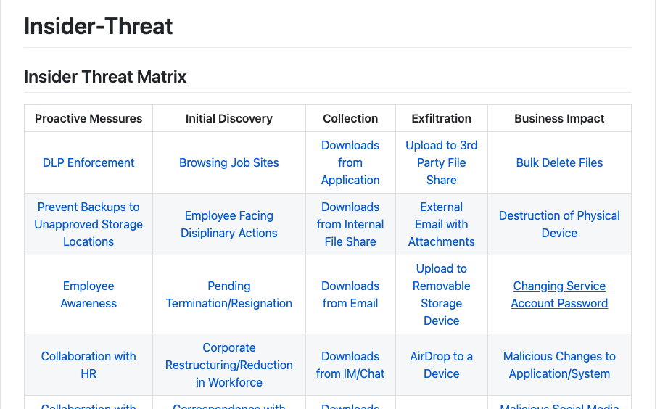
Identify what matters most
​Stop hunting blindly Insider Threats are not singular events, they are like external threat actors, they follow a similar “attack” chain. Source: https://github.com/Insider-Threat/Insider-Threat

Slide 18
​Now it’s time to build stuff!!

Slide 19
Calculated Fields
• High Risk File – keyword-based list to help find files that might be sensitive
•SPL:
•if(match(file, "CONFIDENTIAL, Sensitive, Important_Stuff_In_Here"), "1”, "0")
•Competitors List – keyword based list to help find files related to Competitors
•SPL:
•if(match(file, ”Other_Company, Not_as_Good, Product_Stinks"), "1”, "0")
•More Info: https://docs.splunk.com/Documentation/Splunk/latest/Knowledge/CreatecalculatedfieldswithSplunkWeb

Slide 20
Lookups
• High Risk User – this is used for users that have been identified as:
•Behaving suspiciously
•Part of a reduction in force (RIF)
•Working on a sensitive project
•Fields:
Username | Date added | Status - active or not_active | Notes
•SPL:
index=risk | lookup high_risk_user.csv user as user OUTPUT hru_status notes date_added | search hru_status=”active”
•Pro Tip - keep list access to the lookup limited!
•Easy to update with the Lookup Editor app
•More Info: https://docs.splunk.com/Documentation/SplunkCloud/latest/Knowledge/Usefieldlookupstoaddinformationtoyourevents

Slide 21
eventstats
•eventstats - Generates summary statistics from fields in your events and saves those statistics in a new field.
•SPL:
| eventstats avg(risk_score) as avg_risk stdev(risk_score) as stdev_risk
•Get average risk scores and see how they compare with other users.
•High Risk scores are great but don’t always capture everything
•More Info: https://docs.splunk.com/Documentation/SplunkCloud/latest/SearchReference/Eventstats

Slide 22
eval
•eval – one of the most powerful Splunk commands.
•SPL:
| eval risk_score=if(in(user_prop, "CEO", "CFO", "COO", "Executive Vice President"), risk_score+20,risk_score)
| eval risk_score=if(total_hvf >=1 AND total_hvf <=50, risk_score+10,risk_score) •Great way to apply dynamic scores based on your needs.
•In ES 6.4, see Risk Factors https://docs.splunk.com/Documentation/ES/6.6.0/Admin/Createriskfactors •More Info: https://docs.splunk.com/Documentation/SplunkCloud/latest/SearchReference/Eval

Slide 23
where
•where – The where command uses eval-expressions to filter search results.
•SPL:
| where (risk_score>=75 AND total_hvf>=10 AND (tactic_exfil_value >=100 OR tactic_delete_value>=100))
•Awesome way to help set your threshold and filter out noise
•More Info: https://docs.splunk.com/Documentation/Splunk/Latest/SearchReference/Where

Slide 24
Risk Notable - Threshold
•Risk Notable – A correlation search with a Notable Event attached.
index=risk
| lookup high_risk_user.csv user as user OUTPUT hru_status notes date_added
| search hru_status=”active”
| eval risk_score=if(in(user_prop, "CEO", "CFO", "COO", "Executive Vice President"), risk_mod_count+20,risk_score) | eval risk_score=if(total_hvf >=1 AND total_hvf <=50, risk_mod_count+10,risk_score) | eval aa_tactic_exfil_value=case(aa_tactic == "Exfiltration", "1", aa_tactic == "Collection", "0", aa_tech == "Data_Destruction", "0")
| eval aa_tactic_delete_value=case(aa_tactic == "Exfiltration", "0", aa_tactic == "Collection", "0", aa_tech == "Data_Destruction", "1")
| eventstats avg(risk_score) as avg_risk stdev(risk_score) as stdev_risk
| stats dc(file) as file_count sum(hvf) as total_hvf values( aa_tactic) as aa _tactic values(aa_tech) as aa_tech by user
| where (risk_score>=75 AND total_hvf>=10 AND (tactic_exfil_value >=100 OR tactic_delete_value>=100))

Slide 25
Risk Notable - Multi Tactic
index=risk
| lookup high_risk_user.csv user as user OUTPUT hru_status notes date_added
| search hru_status=”active”
| eval risk_score=if(in(user_prop, "CEO", "CFO", "COO", "Executive Vice President"), risk_mod_count+20,risk_score)
| eval risk_score=if(total_hvf >=1 AND total_hvf <=50, risk_mod_count+10,risk_score)
| eval aa_tactic_exfil_value=case(aa_tactic == "Exfiltration", "1", aa_tactic == "Collection", "0", aa_tech == "Data_Destruction", "0")
| eval aa_tactic_delete_value=case(aa_tactic == "Exfiltration", "0", aa_tactic == "Collection", "0", aa_tech == "Data_Destruction", "1")
| eventstats avg(risk_score) as avg_risk stdev(risk_score) as stdev_risk
| stats dc(file) as file_count sum(hvf) as total_hvf values(aa_tactic) as aa _tactic values(aa_tech) as aa_tech dc(aa_tactic) as aa_tactic_count dc(aa_tech) as aa_tech_count by user
| where (aa_tech_count > 2 OR aa_tech_count >3)

Slide 26
Risk Notable - Anomaly
index=risk
| lookup high_risk_user.csv user as user OUTPUT hru_status notes date_added
| search hru_status=”active”
| eval risk_mod_count=0
| eval risk_score=if(in(user_prop, "CEO", "CFO", "COO", "Executive Vice President"), risk_mod_count+20,risk_score)
| eval risk_score=if(total_hvf >=1 AND total_hvf <=50, risk_mod_count+10,risk_score)
| eval risk_mod_count=if(like(aa_tech,"Correspondence_with_Competitor"),risk_mod_count+30,risk_mod_count)
| eval risk_mod_count=if(like(aa_tech,"Pending_Resignation"),risk_mod_count+30,risk_mod_count)
| eval risk_mod_count=if(like(aa_tech,"Pending_End_of_Contract"),risk_mod_count+30,risk_mod_count)
| eval risk_mod_count=if(like(aa_tech,"Security_Tool_Alerts"),risk_mod_count+30,risk_mod_count)
| eval risk_mod_count=if(like(aa_tech,"Behavior_Based"),risk_mod_count+30,risk_mod_count)
| streamstats sum(risk_score) as risk_score
dc(file) as total_files
sum(high_value_file) as total_hvf
values(source) as source
dc(source) as source_count
values(aa_tactic) as "aa_tactic"
values(aa_tech) as "aa_tech"
dc(aa_tactic) as count_aa_tactic
by user
| stats
dc(file) as total_files
sum(high_value_file) as total_hvf
values(source) as source
dc(source) as source_count
values(aa_tactic) as "aa_tactic"
values(aa_tech) as "aa_tech"
dc(aa_tactic) as count_aa_tactic
max(risk_score) as risk_score
max(avgRisk) as avgRisk
values(stdevRisk) as stdevRisk
by user
| eventstats avg(risk_score) as avg_risk stdev(risk_score) as stdev_risk
| where risk_score>avgRisk+(2*stdevRisk)

Slide 27
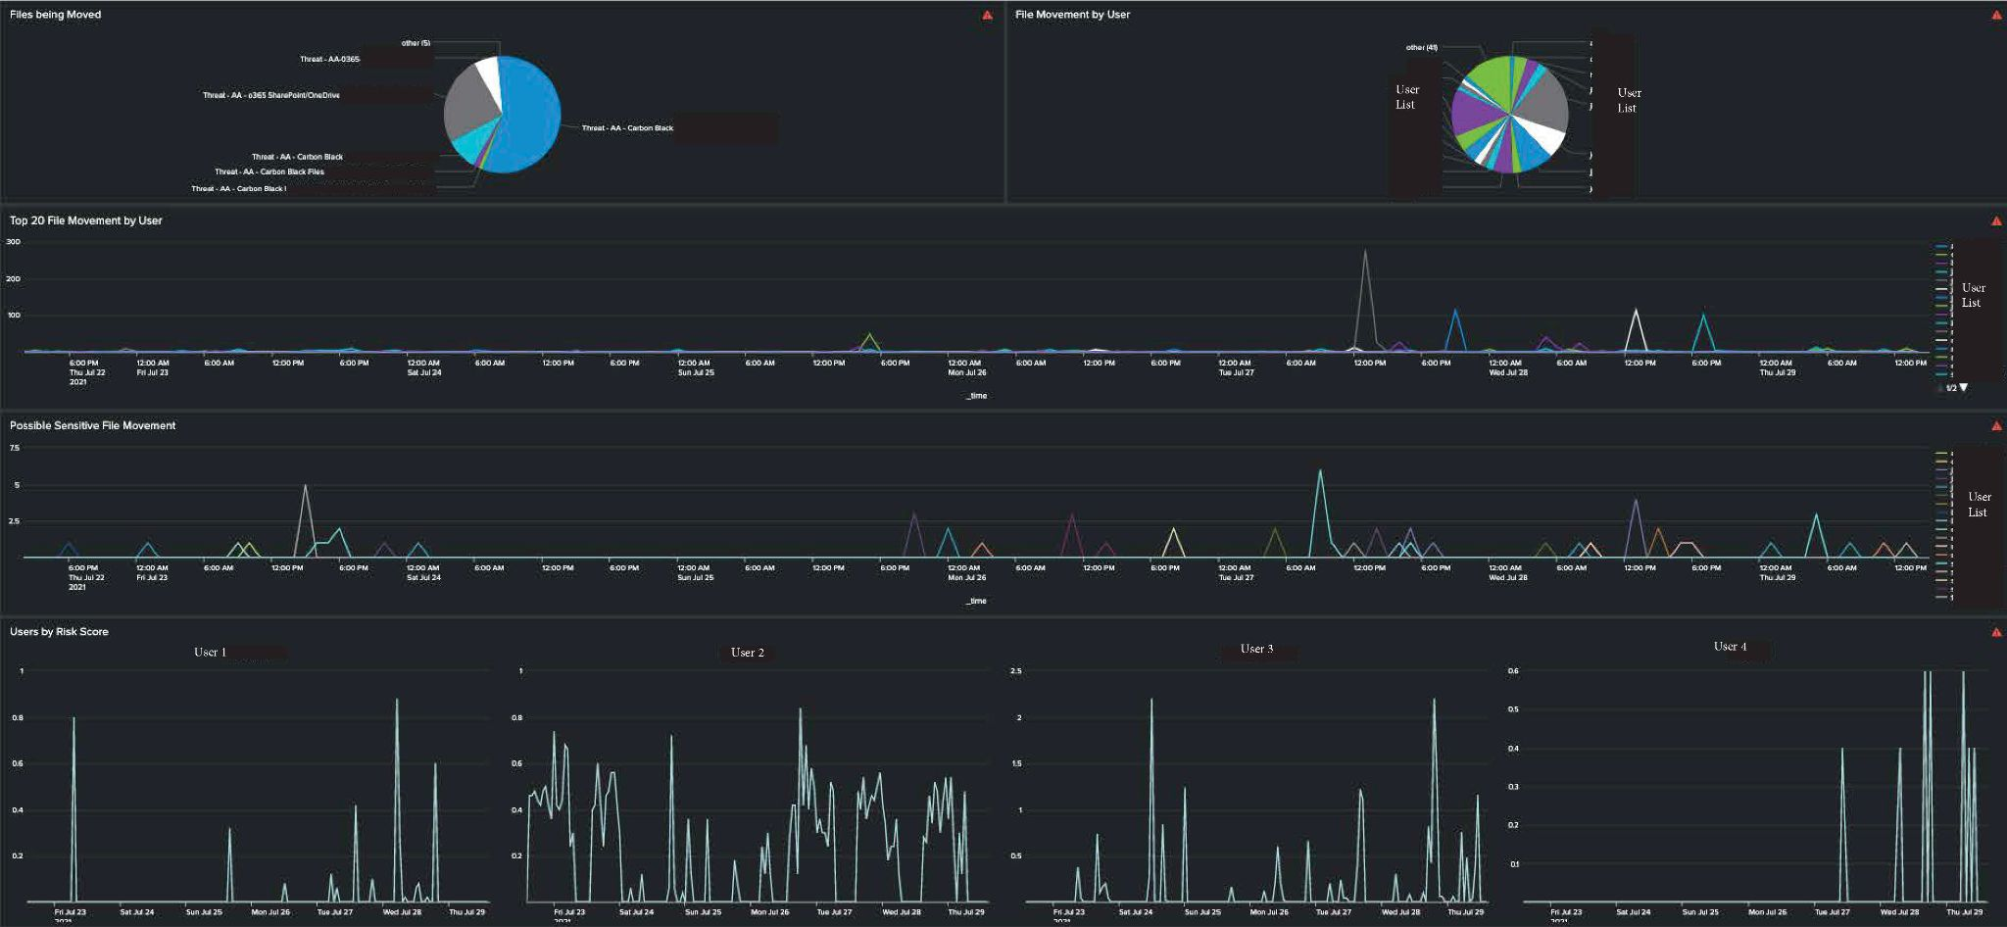
High Risk User Monitoring
​Spot Suspicious Activity An easy-to-use dashboard to find suspicious activity and take action proactively. Source: https://github.com/matt-snyder-stuff/.conf_2021/blob/main/Dashboards/High_Risk_Monitoring

Slide 28
Lessons Learned
Get a head start on your program...
You need the business’s support.
Alerts/Investigations that aren’t actioned mean nothing.
Prioritize and Execute! Start building things that will save you time first!
Automate the small things. Grab files that need to be reviewed, generate email to manager, disable USB connections, etc.
RBA is the way! Your alerts need to be accurate, you don’t get second chances when you accuse an employee of wrongdoing.

Slide 29
But wait, there’s more… How RBA Saved Christmas! A true story.

Slide 30
Helpful Links
Insider Threat Matrix: https://github.com/Insider-Threat/Insider-Threat
Code42 Insider Threat Report: https://www.code42.com/resources/report-2021-data-exposure/
RBA Deck: https://deck.rbaallday.com/
Alerts and Dashboards: https://github.com/matt-snyder-stuff/.conf_2021

Slide 31
RBA 2021 .conf Talks
SEC1163A - Proactive Risk Based Alerting for Insider Threats
SEC1162A - Supercharge Your Risk Based Alerting (RBA) Implementation
SEC1590C - Augmented Case Management With Risk Based Analytics and Splunk SOAR SEC1800A - Implementing Zero Trust: From Hype to Reality
SEC1249A - Accenture’s Journey to RBA with Splunk Enterprise Security and Beyond
SEC1466A - A Deep-Dive Into How Zoom Is Building Its World-Class Detection Pipeline in Response to the Zoom-Boom!

